Slide 1
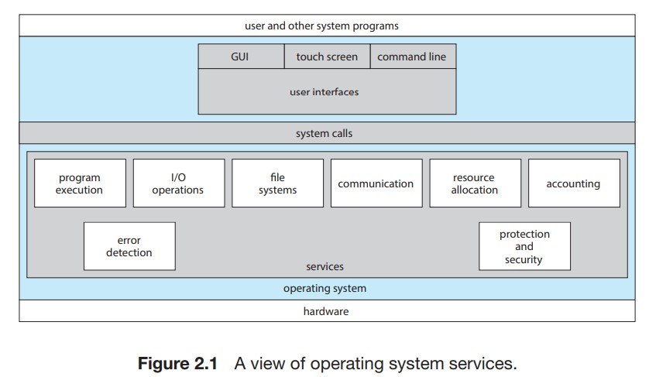
Operating System Services

Slide 2
User interface:
The user interface is something that allows the user to interact with the operating system.
Almost all operating system have user interface and the user interface can take several forms.
Most commonly, a graphical user interface (GUI) is used.
Here, the interface is a window system with a mouse that serves as a pointing device to direct I/O, choose from menus, and make selections and a keyboard to enter text.
Mobile systems such as phones and tablets provide a touch-screen interface, enabling users to slide their fingers across the screen or press buttons on the screen to select choices.
Another option is a command-line interface (CLI), which uses text commands and a method for entering them (say, a keyboard for typing in commands in a specific format with specific options).

Slide 3
Program execution:
The system must be able to load a program into memory and to run that program.
The program must be able to end its execution, either normally or abnormally (indicating error).
I/O operations:
A running program may require I/O, which may involve a file or an I/O device.
For specific devices, special functions may be desired (such as reading from a network interface or writing to a file system).
For efficiency and protection, users usually cannot control I/O devices directly.
Therefore, the operating system must provide a means to do I/O.

Slide 4
File-system manipulation:
The file system is of particular interest.
Obviously, programs need to read and write files and directories.
They also need to create and delete them by name, search for a given file, and list file information.
Finally, some operating systems include permissions management to allow or deny access to files or directories based on file ownership.
Many operating systems provide a variety of file systems, sometimes to allow personal choice and sometimes to provide specific features or performance characteristics.

Slide 5
Communications:
There are many circumstances in which one process needs to exchange information with another process.
Such communication may occur between processes that are executing on the same computer or between processes that are executing on different computer systems tied together by a network.
Communications may be implemented via shared memory, in which two or more processes read and write to a shared section of memory, or message passing, in which packets of information in predefined formats are moved between processes by the operating system.

Slide 6
Error detection:
The operating system needs to be detecting and correcting errors constantly.
Errors may occur in the CPU and memory hardware (such as a memory error or a power failure), in I/O devices (such as a parity error on disk, a connection failure on a network, or lack of paper in the printer), and in the user program (such as an arithmetic overflow or an attempt to access an illegal memory location).
For each type of error, the operating system should take the appropriate action to ensure correct and consistent computing.
Sometimes, it has no choice but to halt the system.
At other times, it might terminate an error-causing process or return an error code to a process for the process to detect and possibly correct.

Slide 7
Resource allocation:
When there are multiple processes running at the same time, resources must be allocated to each of them.
The operating system manages many different types of resources. Some (such as CPU cycles, main memory, and file storage) may have special allocation code, whereas others (such as I/O devices) may have much more general request and release code.
For instance, in determining how best to use the CPU, operating systems have CPU-scheduling routines that take into account the speed of the CPU, the process that must be executed, the number of processing cores on the CPU, and other factors.
There may also be routines to allocate printers, USB storage drives, and other peripheral devices.

Slide 8
Logging:
We want to keep track of which programs use how much and what kinds of computer resources.
This record keeping may be used for accounting (so that users can be billed) or simply for accumulating usage statistics.
Usage statistics may be a valuable tool for system administrators who wish to reconfigure the system to improve computing services.

Slide 9
Protection and security:
The owners of information stored in a multiuser or networked computer system may want to control use of that information.
When several separate processes execute concurrently, it should not be possible for one process to interfere with the others or with the operating system itself.
Protection involves ensuring that all access to system resources is controlled. Security of the system from outsiders is also important.
Such security starts with requiring each user to authenticate himself or herself to the system, usually by means of a password, to gain access to system resources.
It extends to defending external I/O devices, including network adapters, from invalid access attempts and recording all such connections for detection of break-ins.
If a system is to be protected and secure, precautions must be instituted throughout it.
A chain is only as strong as its weakest link.

Slide 10
User and Operating-System Interface
we discuss three fundamental approaches.
One provides a command-line interface, or command interpreter, that allows users to directly enter commands to be performed by the operating system.
The other two allow users to interface with the operating system via a graphical user interface, or GUI.
Command interpreter
Graphical user interface
Touch screen interface
Choice of interface

Slide 11
Command interpreter
Most operating systems, including Linux, UNIX, and Windows, treat the command interpreter as a special program that is running when a process is initiated or when a user first logs on (on interactive systems).
On systems with multiple command interpreters to choose from, the interpreters are known as shells.
For example, on UNIX and Linux systems, a user may choose among several different shells, including the C shell, Bourne-Again shell, Korn shell, and others.
Third-party shells and free user-written shells are also available.
Most shells provide similar functionality, and a user’s choice of which shell to use is generally based on personal preference.

Slide 12
The main function of the command interpreter is to get and execute the next user-specified command.
Many of the commands given at this level manipulate files: create, delete, list, print, copy, execute, and so on.
The various shells available on UNIX systems operate in this way.
These commands can be implemented in two general ways.
In one approach, the command interpreter itself contains the code to execute the command.
For example, a command to delete a file may cause the command interpreter to jump to a section of its code that sets up the parameters and makes the appropriate system call.
In this case, the number of commands that can be given determines the size of the command interpreter, since each command requires its own implementing code.

Slide 13
An alternative approach—used by UNIX, among other operating systems —implements most commands through system programs.
In this case, the command interpreter does not understand the command in any way; it merely uses the command to identify a file to be loaded into memory and executed.
Thus, the UNIX command to delete a file
rm file.txt
would search for a file called rm, load the file into memory, and execute it with the parameter file.txt. The logic associated with the rm command would be defined completely by the code in the file rm.

Slide 14
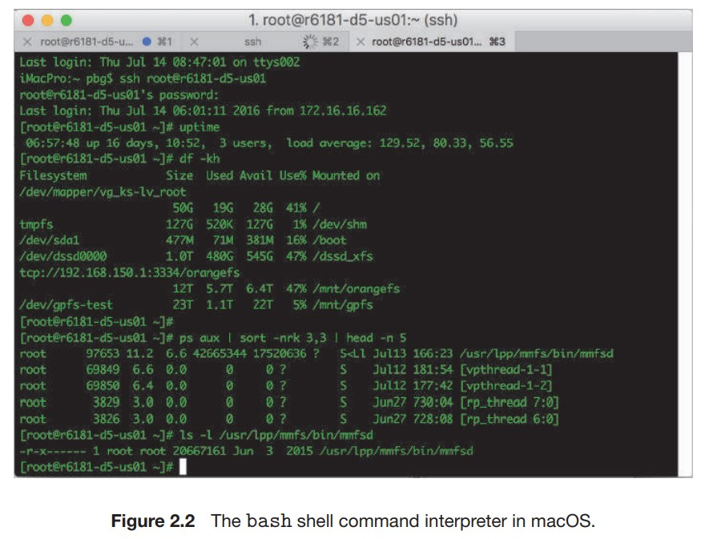

Slide 15
Graphical User Interface
A second strategy for interfacing with the operating system is through a user friendly graphical user interface, or GUI.
Here, rather than entering commands directly via a command-line interface, users employ a mouse-based window and-menu system characterized by a desktop metaphor.
The user moves the mouse to position its pointer on images, or icons, on the screen (the desktop) that represent programs, files, directories, and system functions.
Depending on the mouse pointer’s location, clicking a button on the mouse can invoke a program, select a file or directory—known as a folder—or pull down a menu that contains commands.

Slide 16
Touch-Screen Interface
Because a either a command-line interface or a mouse-and-keyboard system is impractical for most mobile systems, smartphones and handheld tablet computers typically use a touch-screen interface.
Here, users interact by making gestures on the touch screen— for example, pressing and swiping fingers across the screen.
Although earlier smartphones included a physical keyboard, most smartphones and tablets now simulate a keyboard on the touch screen. Figure illustrates the touch screen of the Apple iPhone.
Both the iPad and the iPhone use the Springboard touch-screen interface.

Slide 17
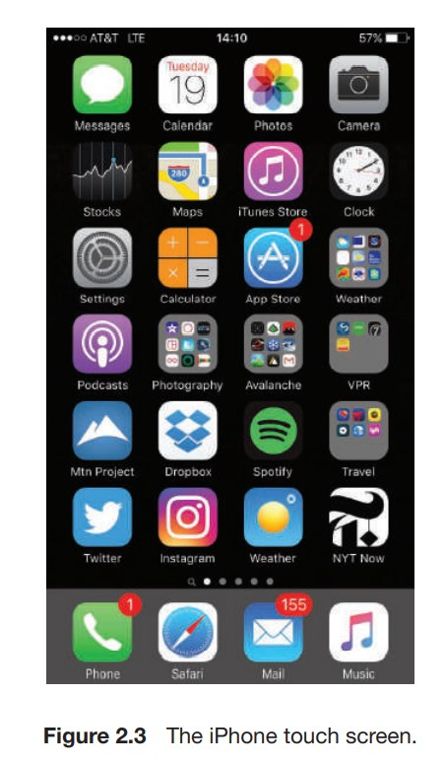

Slide 18
Choice of Interface
The choice of whether to use a command-line or GUI interface is mostly one of personal preference.
System administrators who manage computers and power users who have deep knowledge of a system frequently use the command-line interface.
For them, it is more efficient, giving them faster access to the activities they need to perform.
Indeed, on some systems, only a subset of system functions is available via the GUI, leaving the less common tasks to those who are command-line knowledgeable.
Further, command-line interfaces usually make repetitive tasks easier, in part because they have their own programmability.

Slide 19
For example, if a frequent task requires a set of command line steps, those steps can be recorded into a file, and that file can be run just like a program.
The program is not compiled into executable code but rather is interpreted by the command-line interface.
These shell scripts are very common on systems that are command-line oriented, such as UNIX and Linux.

